Slide 1
Distributed Shared Memory
Pham Quoc Cuong & Phan Dinh Khoi
Use some slides of James Deak - NJIT

Slide 2
Outline
Introduction
Design and Implementation
Sequential consistency and Ivy – case study
Release consistency and Munin – case study
Other consistency models
Distributed Shared Memory
©2008, Pham Quoc Cuong – Phan Dinh Khoi

Slide 3
Outline
Introduction
Design and Implementation
Sequential consistency and Ivy – case study
Release consistency and Munin – case study
Other consistency models
Distributed Shared Memory
©2008, Pham Quoc Cuong – Phan Dinh Khoi

Slide 4
Distributed Shared Memory
Distributed Shared Memory (DSM) allows programs running on separate computers to share data without the programmer having to deal with sending messages
Instead underlying technology will send the messages to keep the DSM consistent (or relatively consistent) between computers
DSM allows programs that used to operate on the same computer to be easily adapted to operate on separate computers
Distributed Shared Memory
©2008, Pham Quoc Cuong – Phan Dinh Khoi

Slide 5
Introduction
Programs access what appears to them to be normal memory
Hence, programs that use DSM are usually shorter and easier to understand than programs that use message passing
However, DSM is not suitable for all situations. Client-server systems are generally less suited for DSM, but a server may be used to assist in providing DSM functionality for data shared between clients
Distributed Shared Memory
©2008, Pham Quoc Cuong – Phan Dinh Khoi

Slide 6
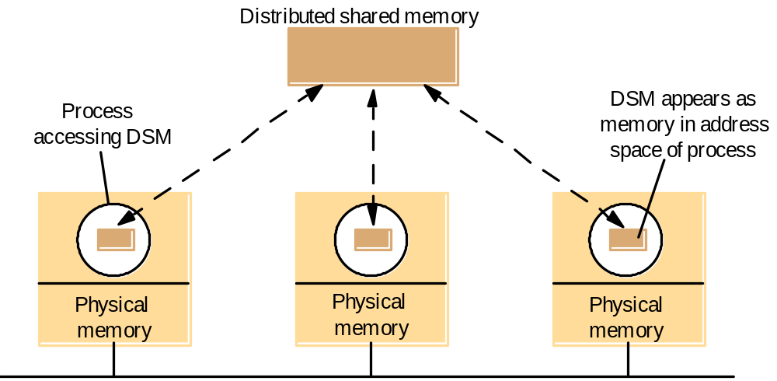
The distributed shared memory abstraction
Distributed Shared Memory
(exists only virtually)
CPU 1
Memory
CPU 1
Memory
CPU 1
Memory
CPU n
CPU n
CPU n
Memory-Mapping Manager
Memory-Mapping Manager
Memory-Mapping Manager
Communication Network
Distributed Shared Memory
©2008, Pham Quoc Cuong – Phan Dinh Khoi

Slide 7
DSM History
Memory mapped files started in the MULTICS operating system in the 1960s
One of the first DSM implementations was Apollo. One of the first system to use Apollo was Integrated shared Virtual memory at Yale (IVY)
DSM developed in parallel with shared-memory multiprocessors
Distributed Shared Memory
©2008, Pham Quoc Cuong – Phan Dinh Khoi

Slide 8
DSM vs Message passing
DSM | Message passing
Variables are shared directly | Variables have to be marshalled yourself
Processes can cause error to one another by altering data | Processes are protected from one another by having private address spaces
Processes may execute with non-overlapping lifetimes | Processes must execute at the same time
Invisibility of communication’s cost | Cost of communication is obvious
Distributed Shared Memory
©2008, Pham Quoc Cuong – Phan Dinh Khoi

Slide 9
Outline
Introduction
Design and Implementation
Sequential consistency and Ivy – case study
Release consistency and Munin – case study
Other consistency models
Distributed Shared Memory
©2008, Pham Quoc Cuong – Phan Dinh Khoi

Slide 10
DSM implementations
Hardware: Mainly used by shared-memory multiprocessors. The hardware resolves LOAD and STORE commands by communicating with remote memory as well as local memory
Paged virtual memory: Pages of virtual memory get the same set of addresses for each program in the DSM system. This only works for computers with common data and paging formats. This implementation does not put extra structure requirements on the program since it is just a series of bytes.
Distributed Shared Memory
©2008, Pham Quoc Cuong – Phan Dinh Khoi

Slide 11
DSM Implementations (continued)
Middleware: DSM is provided by some languages and middleware without hardware or paging support. For this implementation, the programming language, underlying system libraries, or middleware send the messages to keep the data synchronized between programs so that the programmer does not have to.
Distributed Shared Memory
©2008, Pham Quoc Cuong – Phan Dinh Khoi

Slide 12
Efficiency
DSM systems can perform almost as well as equivalent message-passing programs for systems that run on about 10 or less computers.
There are many factors that affect the efficiency of DSM, including the implementation, design approach, and memory consistency model chosen.
Distributed Shared Memory
©2008, Pham Quoc Cuong – Phan Dinh Khoi

Slide 13
Design approaches
Byte-oriented: This is implemented as a contiguous series of bytes. The language and programs determine the data structures
Object-oriented: Language-level objects are used in this implementation. The memory is only accessed through class routines and therefore, OO semantics can be used when implementing this system
Immutable data: Data is represented as a group of many tuples. Data can only be accessed through read, take, and write routines
Distributed Shared Memory
©2008, Pham Quoc Cuong – Phan Dinh Khoi

Slide 14
Memory consistency
To use DSM, one must also implement a distributed synchronization service. This includes the use of locks, semaphores, and message passing
Most implementations, data is read from local copies of the data but updates to data must be propagated to other copies of the data
Memory consistency models determine when data updates are propagated and what level of inconsistency is acceptable
Distributed Shared Memory
©2008, Pham Quoc Cuong – Phan Dinh Khoi

Slide 15
Two processes accessing shared variables
Process 1
Process 2
br := b;
a := a + 1;
a
r := a;
b := b + 1;
if(ar ≥ br) then
print ("OK");
Distributed Shared Memory
©2008, Pham Quoc Cuong – Phan Dinh Khoi

Slide 16
Memory consistency models
Linearizability or atomic consistency is the strongest model. It ensures that reads and writes are made in the proper order. This results in a lot of underlying messaged being passed.
  Variables can only be changed by a write operation
  The order of operations is consistent with the real times at which the operations occurred in the actual execution
Sequential consistency is strong, but not as strict. Reads and writes are done in the proper order in the context of individual programs.
  The order of operations is consistent with the program order in which each individual client executed them
Distributed Shared Memory
©2008, Pham Quoc Cuong – Phan Dinh Khoi

Slide 17
Memory consistency models (continued)
Coherence has significantly weaker consistency. It ensures writes to individual memory locations are done in the proper order, but writes to separate locations can be done in improper order
Weak consistency requires the programmer to use locks to ensure reads and writes are done in the proper order for data that needs it
Distributed Shared Memory
©2008, Pham Quoc Cuong – Phan Dinh Khoi

Slide 18
Interleaving under sequential consistency
Process 1
Time
Process 2
read
br := b;
ar
:= a;
a := a + 1;
if(ar ≥ br) then
b := b + 1;
print ("OK");
write
Distributed Shared Memory
©2008, Pham Quoc Cuong – Phan Dinh Khoi

Slide 19
Update options
Write-update: Each update is multicast to all programs. Reads are performed on local copies of the data
Write-invalidate: A message is multicast to each program invalidating their copy of the data before the data is updated. Other programs can request the updated data
Distributed Shared Memory
©2008, Pham Quoc Cuong – Phan Dinh Khoi

Slide 20
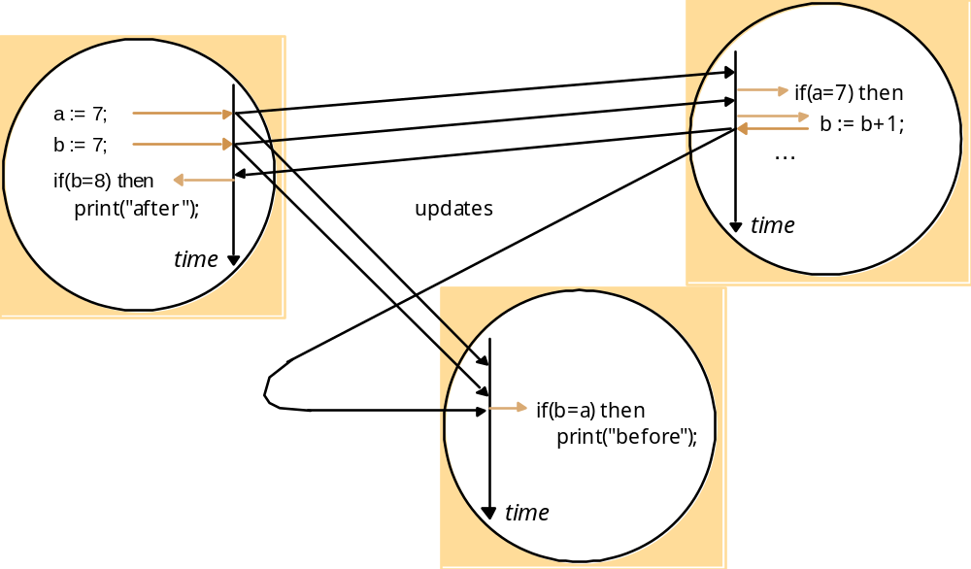
DSM using write-update
Distributed Shared Memory
©2008, Pham Quoc Cuong – Phan Dinh Khoi

Slide 21
Granularity
Granularity is the amount of data sent with each update
If granularity is too small and a large amount of contiguous data is updated, the overhead of sending many small messages leads to less efficiency
If granularity is too large, a whole page (or more) would be sent for an update to a single byte, thus reducing efficiency
Distributed Shared Memory
©2008, Pham Quoc Cuong – Phan Dinh Khoi

Slide 22
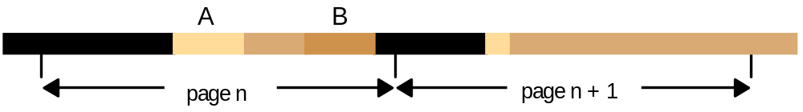
Data items laid out over pages
Distributed Shared Memory
©2008, Pham Quoc Cuong – Phan Dinh Khoi

Slide 23
Trashing
Thrashing occurs when network resources are exhausted, and more time is spent invalidating data and sending updates than is used doing actual work
Based on system specifics, one should choose write-update or write-invalidate to avoid thrashing
Distributed Shared Memory
©2008, Pham Quoc Cuong – Phan Dinh Khoi

Slide 24
Outline
Introduction
Design and Implementation
Sequential consistency and Ivy – case study
Release consistency and Munin – case study
Other consistency models
Distributed Shared Memory
©2008, Pham Quoc Cuong – Phan Dinh Khoi

Slide 25
Sequential consistency and Ivy case study
This model is page-based
A single segment is shared between programs
The computers are equipped with a paged memory management unit
The DSM restricts data access permissions temporarily in order to maintain sequential consistency
Permissions can be none, read-only, or read-write
Distributed Shared Memory
©2008, Pham Quoc Cuong – Phan Dinh Khoi

Slide 26
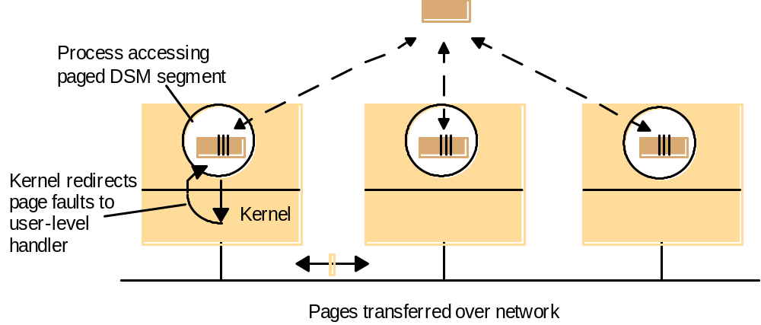
System model for page-based DSM
Distributed Shared Memory
©2008, Pham Quoc Cuong – Phan Dinh Khoi

Slide 27
Write-update
If a program tries to do more than it has permission for, a page fault occurs and the program is block until the page fault is resolved
If writes can be buffered, write-updated is used
Distributed Shared Memory
©2008, Pham Quoc Cuong – Phan Dinh Khoi

Slide 28
Write-invalidate
If writes cannot be buffered, write-invalidate is used
The invalidation message acts as requesting a lock on the data
When one program is updating the data it has read-write permissions and everyone else has no permissions on that page
At all other times, all have read-only access to the page
Distributed Shared Memory
©2008, Pham Quoc Cuong – Phan Dinh Khoi

Slide 29
State transitions under write-invalidation
Single writer
Multiple reader
R
P
W
writes;
P
R1
, P
R2
,..P
Rn
read;
none read
none write
W
(invalidation)
W
R
(invalidation)
Note: R = read fault occurs; W = write fault occurs.
Distributed Shared Memory
©2008, Pham Quoc Cuong – Phan Dinh Khoi

Slide 30
Terminology
copyset (p): the set of process that have a copy of page p
owner(p): a process with the most up-to-date version of a page p
Distributed Shared Memory
©2008, Pham Quoc Cuong – Phan Dinh Khoi

Slide 31
Write page-fault handling
Process P_{W} attempts to write a page p to which it does not have permission
  The page p is transferred to P_{w} if it has not an up-to-date read-only copy
  An invalidate message is sent to all member of copyset(p)
  copyset(p) = {P_{w}}
  owner(p) = P_{w}
Distributed Shared Memory
©2008, Pham Quoc Cuong – Phan Dinh Khoi

Slide 32
Read page-fault handling
If a process P_{R} attempts to read a page p for which it does not have permissions
  The page is copied from owner(p) to P_{R}
  If current owner is a single writer => its access permission for p is set to read-only
  Copyset(p) = copyset(p) ∪{P_{R}}
Distributed Shared Memory
©2008, Pham Quoc Cuong – Phan Dinh Khoi

Slide 33
Problems with invalidation protocols
How to locate owner(p) for a given page p
Where to store copyset(p)
Distributed Shared Memory
©2008, Pham Quoc Cuong – Phan Dinh Khoi

Slide 34
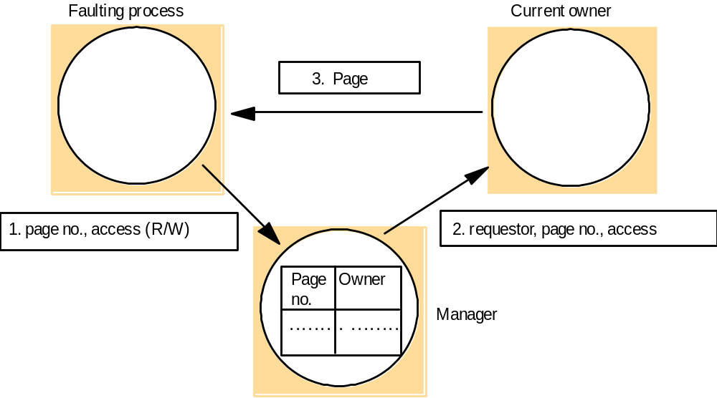
Central manager and associated messages
Distributed Shared Memory
©2008, Pham Quoc Cuong – Phan Dinh Khoi

Slide 35
Alternative manager strategy
A central manager may become a performance bottleneck
There are a three alternatives:
  Fixed distributed page management where on program will manage a set of pages for its lifetime (even if it does not own them)
  Multicast-based management where the owner of a page manages it, read and write requests are multicast, only the owner answers
  Dynamic distributed management where each program keeps a set of the probable owner(s) of each page
Distributed Shared Memory
©2008, Pham Quoc Cuong – Phan Dinh Khoi

Slide 36
Dynamic distributed manager
Initially each process is supplied with accurate page locations
transfers
invalidation
p
p
probOwner(p)
probOwner(p)
P_{i}
P_{j}
P_{i}
P_{j}
request read
request
P_{i}
P_{j}
P_{i}
P_{j}
probOwner(p)
probOwner(p)
granted read
Forward request
Distributed Shared Memory
©2008, Pham Quoc Cuong – Phan Dinh Khoi

Slide 37
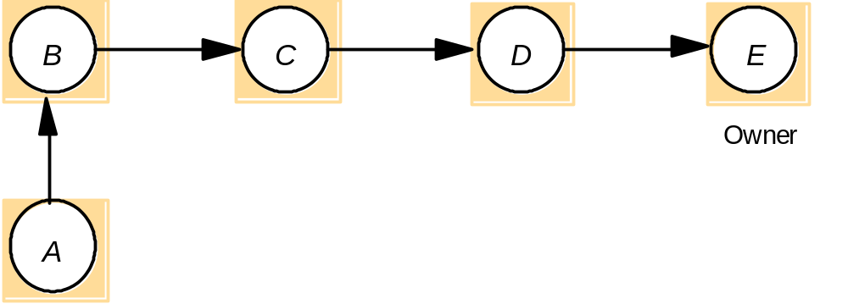
Updating probOwner pointers
(a) probOwner pointers just before process A takes a page fault for a page owned by E
Distributed Shared Memory
©2008, Pham Quoc Cuong – Phan Dinh Khoi

Slide 38
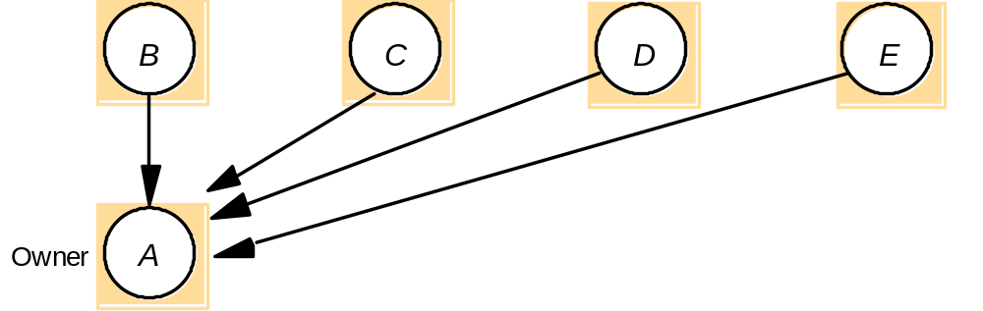
Updating probOwner pointers
(b) Write fault: probOwner pointers after A's write request is forwarded
Distributed Shared Memory
©2008, Pham Quoc Cuong – Phan Dinh Khoi

Slide 39
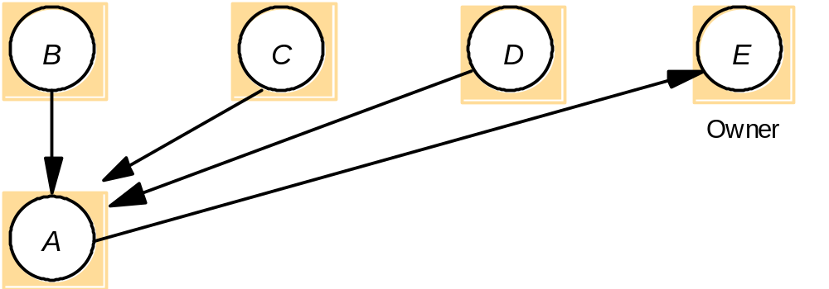
Updating probOwner pointers
(c) Read fault: probOwner pointers after A's read request is forwarded
Distributed Shared Memory
©2008, Pham Quoc Cuong – Phan Dinh Khoi

Slide 40
Outline
Introduction
Design and Implementation
Sequential consistency and Ivy – case study
Release consistency and Munin – case study
Other consistency models
Distributed Shared Memory
©2008, Pham Quoc Cuong – Phan Dinh Khoi

Slide 41
Release consistency and Munin case study
Be weaker than sequential consistency, but cheaper to implement
Reduce overhead
Used semaphores, locks, and barriers to achieve enough consistency
Distributed Shared Memory
©2008, Pham Quoc Cuong – Phan Dinh Khoi

Slide 42
Memory accesses
Types of memory accesses:
  Competing accesses
    They may occur concurrently – there is no enforced ordering between them
    At least one is a write
  Non-competing or ordinary accesses
    All read-only access, or enforced ordering
Distributed Shared Memory
©2008, Pham Quoc Cuong – Phan Dinh Khoi

Slide 43
Competing Memory Access
Competing memory accesses are divided into two categories:
  Synchronization accesses are concurrent and contribute to synchronization
  Non-synchronization accesses are concurrent but do not contribute to synchronization
Distributed Shared Memory
©2008, Pham Quoc Cuong – Phan Dinh Khoi

Slide 44
Release consistency requirements
To achieve release consistency, the system must:
  Preserve synchronization with locks
  Gain performance by allowing asynchronous memory operations
  Limit the overlap between memory operations
Distributed Shared Memory
©2008, Pham Quoc Cuong – Phan Dinh Khoi

Slide 45
Release consistency requirements
One must acquire appropriate permissions before performing memory operations
All memory operations must be performed before releasing memory
Acquiring permissions and releasing memory
Distributed Shared Memory
©2008, Pham Quoc Cuong – Phan Dinh Khoi

Slide 46
Munin
Munin had programmers use acquireLock, releaseLock, and waitAtBarrier
Munin sends updates/invalidations when locks are released
  An alternative has the update/invalidation sent when the lock is next acquired
Distributed Shared Memory
©2008, Pham Quoc Cuong – Phan Dinh Khoi

Slide 47
Processes executing on a release-consistent DSM
Process 1:
acquireLock(); // enter critical section
a := a + 1;
b := b + 1;
releaseLock(); // leave critical section
Process 2:
acquireLock(); // enter critical section
print ("The values of a and b are: ", a, b);
releaseLock(); // leave critical section
Distributed Shared Memory
©2008, Pham Quoc Cuong – Phan Dinh Khoi

Slide 48
Munin: Sharing annotations
The following are options with Munin on the data item level:
  Using write-update or write-invalidate
  Whether several copies of data may exist
  Whether to send updates/invalidate immediately
  Whether a data has a fixed owner, and whether that data can be modified by several at once
  Whether the data can be modified at all
  Whether the data is shared by a fixed set of programs
Distributed Shared Memory
©2008, Pham Quoc Cuong – Phan Dinh Khoi

Slide 49
Munin: Standard annotations
Read-only: Initialized, but not allow to be updated
Migratory: Programs access a particular data item in turn
Write-shared: Programs access the same data item, but write to different parts of the data item
Producer-consumer:
  One program write to the data item
  A fixed set of programs read it
Reduction: The data is always locked, read, updated, and unlocked
Result: Several programs write to different parts of one data item. One program reads it
Conventional: Data is managed using write-invalidate
Distributed Shared Memory
©2008, Pham Quoc Cuong – Phan Dinh Khoi

Slide 50
Outline
Introduction
Design and Implementation
Sequential consistency and Ivy – case study
Release consistency and Munin – case study
Other consistency models
Distributed Shared Memory
©2008, Pham Quoc Cuong – Phan Dinh Khoi

Slide 51
Other consistency models
Casual consistency – The happened – before relationship can be applied to read and write operations
Pipelining RAM – Programs apply write operations through pipelining
Processor consistency – Pipelining RAM plus memory coherent
Distributed Shared Memory
©2008, Pham Quoc Cuong – Phan Dinh Khoi

Slide 52
Other consistency models
Entry consistency – Every shared data item is paired with a synchronization object
Scope consistency – Locks are applied automatically to data objects instead of relying on programmers to apply locks
Weak consistency – Guarantees that previous read and write operations complete before acquire or release operations
Distributed Shared Memory
©2008, Pham Quoc Cuong – Phan Dinh Khoi

Slide 53
Summary
Design and Implementation
Sequential consistency and Ivy – case study
Release consistency and Munin – case study
Other consistency models
Distributed Shared Memory
©2008, Pham Quoc Cuong – Phan Dinh Khoi

